Slide 1
Deep Learning for Lung and Colon Cancer Classification Using LC25000

Slide 2
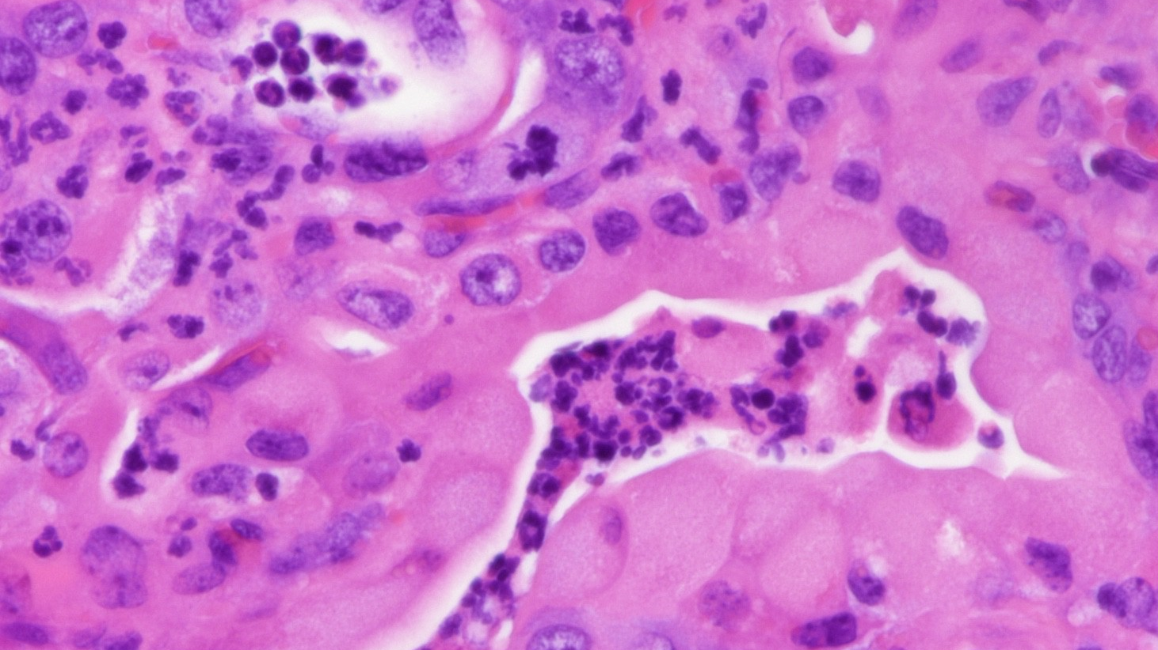
Targeted Problem
The targeted problem is the accurate and efficient diagnosis of lung and colon cancer based on histopathological images. Histopathological analysis, which involves examining tissue samples under a microscope, is a crucial step in cancer diagnosis.
Research Questions
Can a deep learning model be developed to accurately classify lung and colon cancer histopathological images into their respective categories (colon adenocarcinoma, benign colonic tissue, lung adenocarcinoma, lung squamous cell carcinoma, benign lung tissue)?
Can the model be integrated into a clinical workflow to assist pathologists in their diagnostic tasks?
Dataset: LC25000
Origin: The LC25000 dataset was created by a team of researchers from the University of California, Irvine.
Description: It is a large-scale histopathological image dataset containing 25,000 color images of lung and colon tissues. These images are divided into five classes: colon adenocarcinoma, benign colonic tissue, lung adenocarcinoma, lung squamous cell carcinoma, and benign lung tissue. Each class has 5,000 images.
Size: The dataset consists of 25,000 images, each with a resolution of 768x768 pixels.
Link: LC25000 Lung and colon histopathological image dataset - Academic Torrents
Motivation
Technical Motivation: Advance computer vision, improve medical image analysis, leverage data-driven approaches
Personal Motivation: Impact healthcare, career development.
This Photo by Unknown Author is licensed under CC BY

